Slide 1
POVs & Experience Prototypes
Team 2 (BetterUs 👨‍👩‍👧‍👦)
Caring From Within
Problem Domain - Parenting

Slide 2



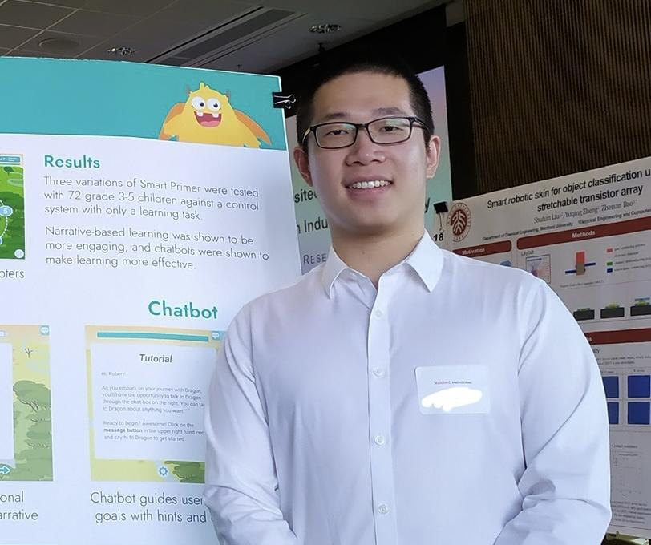
Our Team
Meng Guo
M.S. Symbolic Systems, C/O ‘23
Catherine Horkay
B.S. Computer Science (HCI),
C/O ‘23
Dyllen Nellis
B.S. Human-Centered Design and Engineering,
C/O ‘24
Rui Ying
M.S. Computer Science (HCI), C/ O ‘23

Slide 3
Problem Domain
Parenting

Slide 4
Initial POV
We met Jiayue, a data analyst who just came
to the US and had a 12 day old newborn baby.
We were surprised to notice that she really emphasized how difficult her recovery was after giving birth.
We wonder if this means she feels insecure and useless during the first few weeks after giving birth.
It would be game-changing to help new moms tackle their insecurity right after a baby is born.

Slide 5
Additional
Needfinding
Additional
Needfinding

Slide 6

“In that time of disobedience, instead of wasting thoughts on her father’s absence, she was able to redirect her depression and angst into sports.”
Tina
Financial Professional
Previously employed at a daycare and elementary school.
Single Mom
16-year-old girl, 14-year-old boy, and 6-year-old girl

Slide 7
Surprises & contradictions:
The father’s absence contributed to her pre-teen’s disobedience by bringing boys home; Tina wants to prevent her girls from making the same mistakes she made.
Tina was often whooped by her mom while she was a child. Though she knows it’s harmful, she sometimes punishes her kids physically too.
Insights:
Some parents might resort to physical punishment when they don’t have effective ways to handle conflicts, even if they know it’s harmful.
Building healthy relationships is important for development and well-being.
Notes:
Surprises & contradictions:
The father’s absence contributed to her pre-teen’s disobedience by bringing boys home; Tina wants to avoid her girls making the same mistake as hers.
Tina was often hit by her mom while she was a child. Though she knows it’s harmful, she sometimes punishes her kids physically too.
Insights:
Some parents might resort to physical punishment, when they don’t have effective ways to handle conflicts, even if they know it’s harmful.
Building healthy relationships are important for both parents and kids.

Slide 8

“I'm not gonna go out and read books or use apps and this and that. Parenting has been around for a very long time. You can just figure it out and learn on the fly. Or maybe I'm just not that deep.”
Felipe
Extreme User
Electrical Engineer
Male parental figure to the daughter
of his girlfriend for the past 2 years.
Grew up with his grandfather
as his father figure.
8-year-old girl

Slide 9
Surprises & contradictions:
Felipe thinks he can figure out parenting naturally, though he struggles to balance authority and fun with the child.
He is paranoid that the child hiding candy wrappers will lead to an eating disorder in her teenage years.
Insights:
Parents might change their parenting style if they understand the benefits of parenting styles other than the ones they received as a child.
Parents may worry about secrecy and prefer transparent communication in childhood development.
Notes:
Surprises & contradictions:
Felipe thinks they can figure parenting out naturally, though the relationships within his household is pretty complicated.
He is paranoid that the child hiding candy wrappers will lead to an eating disorder in her teenage years.
Insights:
Parents might change their parenting style if they see the benefits of parenting styles other than the ones they received as a child.
Parents may worry about secrecy and prefers transparent communication in childhood development.

Slide 10
Additional
Needfinding
Revised POVs & HMWs

Slide 11
POV 1
We met Kimsa, a married school nurse with a 15 month old girl and a 3.5 year old girl who lives in San Diego. We were surprised to notice that even after researching parenting thoroughly, the conflicting advice from multiple sources has made her feel stressed rather than calm. We wonder if this means Kimsa feels inadequate with her parenting efforts, and that she is missing crucial information. It would be game-changing to find a way to help parents collect and analyze parenting advice based on their own situation.
Notes:
Other HMWs (* means how many of us like this POV)
Find high-quality advice on parenting to give to parents
Help parents find the advice that’s most suitable for their family *
Give immediate responses when parents need advice
Get parents to discuss conflicting advice with each other **
Make parents feel less inadequate in their parenting efforts ***
Validate parents decisions to avoid overthinking and second-guessing
Make parents feel less overwhelmed by all the different parenting advice that exists **
Give parents a way to know what the right thing to do is
Make parents always do the right thing for their children*
Remove harmful advice from parents’ source of information
Help parents be confident at making parenting decisions** without listening to other advice
See different possibilities they can go after taking some advice
Feel happy to read parenting advice instead of feeling stressed**

Slide 12
POV 1
We met Kimsa, a married school nurse with a 15 month old girl and a 3.5 year old girl who lives in San Diego. We were surprised to notice that even after researching parenting thoroughly, the conflicting advice from multiple sources has made her feel stressed rather than calm. We wonder if this means Kimsa feels inadequate with her parenting efforts, and that she is missing crucial information. It would be game-changing to find a way to help parents collect and analyze parenting advice based on their own situation.
How might we…
make parents feel less inadequate in their parenting efforts?
make parents feel less overwhelmed by all the different parenting advice that exists?
help parents be confident at making parenting decisions?
make parents feel happy to read parenting advice instead of feeling stressed?
Notes:
Other HMWs (* means how many of us like this POV)
Find high-quality advice on parenting to give to parents
Help parents find the advice that’s most suitable for their family *
Give immediate responses when parents need advice
Get parents to discuss conflicting advice with each other **
Make parents feel less inadequate in their parenting efforts ***
Validate parents decisions to avoid overthinking and second-guessing
Make parents feel less overwhelmed by all the different parenting advice that exists **
Give parents a way to know what the right thing to do is
Make parents always do the right thing for their children*
Remove harmful advice from parents’ source of information
Help parents be confident at making parenting decisions** without listening to other advice
See different possibilities they can go after taking some advice
Feel happy to read parenting advice instead of feeling stressed**

Slide 13
POV 2
We met Tina, a financial professional who has a 16-year-old girl, a 14-year-old boy, and a 6-year-old girl. We were surprised to learn that Tina punishes her children by hitting them, but much less frequently than how her own parents would her. We wonder if this means Tina knows physical punishment is bad for child development (based off her own experience), but resorts to it only when she lacks another effective way to handle conflict. It would be game-changing to help parents handle conflict in the moment it is necessary.
Notes:
Other HMWs (* means how many of us like this POV)
Educate parents on how to handle conflict with their children and provide multiple effective and healthy ways to go about resolution
Encourage 2-way communication between the parent and child during conflict to promote greater understanding *
Prevent parents from lashing out at their children in a hurtful manner *
Intervene and assess the conflict so that we can provide advice
Determine solutions to the current conflict
Include children in the handling of parenting conflicts **
Provide instant feedback to what a parent/kid is saying and how they handle conflicts*
Calm parents down to avoid irrational actions when parents are having conflicts with children/Make parents stay calm during a conflict **
Create a safe space for parents and children to admit their faults*
Educate parents to prevent conflict from happening in the first place**
Remove conflicts entirely
Make conflicts a good thing for parents and kids - foster/encourage productive conflict***
Make parents handle conflicts in an educational way*

Slide 14
POV 2
We met Tina, a financial professional who has a 16-year-old girl, a 14-year-old boy, and a 6-year-old girl. We were surprised to learn that Tina punishes her children by hitting them, but much less frequently than how her own parents would her. We wonder if this means Tina knows physical punishment is bad for child development (based off her own experience), but resorts to it only when she lacks another effective way to handle conflict. It would be game-changing to help parents handle conflict in the moment it is necessary.
How might we…
make conflicts a good thing for parents and kids and foster productive conflict?
calm parents down to avoid irrational actions during a conflict?
educate parents to prevent conflict from happening in the first place?
include children in the handling of parenting conflicts?
Notes:
Other HMWs (* means how many of us like this POV)
Educate parents on how to handle conflict with their children and provide multiple effective and healthy ways to go about resolution
Encourage 2-way communication between the parent and child during conflict to promote greater understanding *
Prevent parents from lashing out at their children in a hurtful manner *
Intervene and assess the conflict so that we can provide advice
Determine solutions to the current conflict
Include children in the handling of parenting conflicts **
Provide instant feedback to what a parent/kid is saying and how they handle conflicts*
Calm parents down to avoid irrational actions when parents are having conflicts with children/Make parents stay calm during a conflict **
Create a safe space for parents and children to admit their faults*
Educate parents to prevent conflict from happening in the first place**
Remove conflicts entirely
Make conflicts a good thing for parents and kids - foster/encourage productive conflict***
Make parents handle conflicts in an educational way*

Slide 15
POV 3
We met Monica, a single mom working as a tech recruiter, with her baby born during COVID-19. We were amazed to find that she felt relieved and grateful for her baby after she found out that all moms are struggling. We wonder if this means parents need an outlet for their negative emotions while they might be uncomfortable or unable to share with close family and friends. It would be game-changing to find a way to encourage parents to share their emotions with fellow parents.
Notes:
Other HMWs (* means how many of us like this POV)
Help create a safe place for parents to share their negative feelings
Let parents know that they are not alone in bringing up the child
Help parents get attention or support from a community besides their family members
Provide easily accessible mental support for parents when they experience emotional breakdown
help parents realize that how they feel also matters**
Help partners/co-parents better understand each other while bringing up the child together
Listen to distressed parents or children, alleviate negativity, and promote solutions **
Allow for parents to communicate with other parents of their identity group(s)
Let parents vent but the vent space be a positive space instead of a complaining hub *
Make parents willing / more active in sharing their thoughts and emotions
Make meaningful ways for parents to share their emotions
Keep the sharing space useful, not harmful*
Reframe their negative emotions into positive ones*
Make emotions of the parents one of the most important things in bringing up the child
Make emotion sharing less terrifying and more satisfying ****
Help kids understand their parents’ emotions and actions **
Make parents less suffering from parenting / make parenting more enjoyable *

Slide 16
POV 3
We met Monica, a single mom working as a tech recruiter, with her baby born during COVID-19. We were amazed to find that she felt relieved and grateful for her baby after she found out that all moms are struggling. We wonder if this means parents need an outlet for their negative emotions while they might be uncomfortable or unable to share with close family and friends. It would be game-changing to find a way to encourage parents to share their emotions with fellow parents.
How might we…
make emotion sharing less terrifying and more satisfying?
help kids understand their parents’ emotions and actions?
listen to distressed parents or children, alleviate negativity, and promote solutions?
help parents realize that how they feel also matters?
Notes:
Other HMWs (* means how many of us like this POV)
Help create a safe place for parents to share their negative feelings
Let parents know that they are not alone in bringing up the child
Help parents get attention or support from a community besides their family members
Provide easily accessible mental support for parents when they experience emotional breakdown
help parents realize that how they feel also matters**
Help partners/co-parents better understand each other while bringing up the child together
Listen to distressed parents or children, alleviate negativity, and promote solutions **
Allow for parents to communicate with other parents of their identity group(s)
Let parents vent but the vent space be a positive space instead of a complaining hub *
Make parents willing / more active in sharing their thoughts and emotions
Make meaningful ways for parents to share their emotions
Keep the sharing space useful, not harmful*
Reframe their negative emotions into positive ones*
Make emotions of the parents one of the most important things in bringing up the child
Make emotion sharing less terrifying and more satisfying ****
Help kids understand their parents’ emotions and actions **
Make parents less suffering from parenting / make parenting more enjoyable *

Slide 17
Additional
Needfinding
Top 3 HMWs

Slide 18
HMW 1
How might we make parents feel less inadequate in their parenting efforts?
We met Kimsa, a married school nurse with a 15 month old girl and a 3 and ½ year old girl who lives in San Diego.
We were amazed to learn that even after researching parenting thoroughly, the conflicting advice from multiple sources has made her feel stressed rather than calm.
We wonder if this means Kimsa feels inadequate with her parenting efforts, and that she is missing crucial information.
It would be game-changing to find a way to help parents collect and analyze parenting advice based on their own situation.
Notes:
Other HMWs (* means how many of us like this POV)
Find high-quality advice on parenting to give to parents
Help parents find the advice that’s most suitable for their family *
Give immediate responses when parents need advice
Get parents to discuss conflicting advice with each other **
Make parents feel less inadequate in their parenting efforts ***
Validate parents decisions to avoid overthinking and second-guessing
Make parents feel less overwhelmed by all the different parenting advice that exists **
Give parents a way to know what the right thing to do is
Make parents always do the right thing for their children*
Remove harmful advice from parents’ source of information
Help parents be confident at making parenting decisions** without listening to other advice
See different possibilities they can go after taking some advice
Feel happy to read parenting advice instead of feeling stressed**

Slide 19
HMW 2
How might we make conflict a good thing for
parents and kids and foster productive conflict?
We met Tina, a financial professional who has a 16-year-old girl, a 14-year-old boy, and a 6-year-old girl. We were amazed to learn that Tina punishes her children by hitting them, but much less frequently than how her own parents would her. We wonder if this means Tina knows physical punishment is bad for child development (based off her own experience), but resorts to it only when she lacks another effective way to handle conflict. It would be game-changing to help parents handle conflict in the moment it is necessary.
Notes:
Help create a safe place for parents to share their negative feelings
Let parents know that they are not alone in bringing up the child
Help parents get attention or support from a community besides their family members
Provide easily accessible mental support for parents when they experience emotional breakdown
help parents realize that how they feel also matters**
Help partners/co-parents better understand each other while bringing up the child together
Listen to distressed parents or children, alleviate negativity, and promote solutions **
Allow for parents to communicate with other parents of their identity group(s)
Let parents vent but the vent space be a positive space instead of a complaining hub *
Make parents willing / more active in sharing their thoughts and emotions
Make meaningful ways for parents to share their emotions
Keep the sharing space useful, not harmful*
Reframe their negative emotions into positive ones*
Make emotions of the parents one of the most important things in bringing up the child
Make emotion sharing less terrifying and more satisfying ****
Help kids understand their parents’ emotions and actions **
Make parents less suffering from parenting / make parenting more enjoyable *

Slide 20
HMW 3
How might we make emotion sharing less terrifying and more satisfying?
We met Monica, a single mom working as a tech recruiter, with her baby born during COVID-19.
We were amazed to find that she felt relieved and grateful for her baby after she found out that all moms are struggling.
We wonder if this means parents need an outlet for their negative emotions while they might be uncomfortable or unable to share with close family and friends.
It would be game-changing to find a way to encourage parents to share their emotions with fellow parents.
Notes:
Help create a safe place for parents to share their negative feelings
Let parents know that they are not alone in bringing up the child
Help parents get attention or support from a community besides their family members
Provide easily accessible mental support for parents when they experience emotional breakdown
help parents realize that how they feel also matters**
Help partners/co-parents better understand each other while bringing up the child together
Listen to distressed parents or children, alleviate negativity, and promote solutions **
Allow for parents to communicate with other parents of their identity group(s)
Let parents vent but the vent space be a positive space instead of a complaining hub *
Make parents willing / more active in sharing their thoughts and emotions
Make meaningful ways for parents to share their emotions
Keep the sharing space useful, not harmful*
Reframe their negative emotions into positive ones*
Make emotions of the parents one of the most important things in bringing up the child
Make emotion sharing less terrifying and more satisfying ****
Help kids understand their parents’ emotions and actions **
Make parents less suffering from parenting / make parenting more enjoyable *

Slide 21
Additional
Needfinding
Solutions, Assumptions, &
Experience Prototypes

Slide 22
Solution 1
A quiz to provide parents with personalized parenting advice depending on the specific needs and circumstances
of the parent and child.

Slide 23
Solution 1
Assumption:
Parents are receptive to personalized, external feedback and willing to adjust their parenting style accordingly.
Solution:
A quiz to provide parents with personalized parenting advice depending on the specific needs and circumstances of the parent and child.
Notes:
Assumptions: Parents are receptive to personalized, external feedback and willing to adjust their parenting style accordingly.
listening to advice from an app and adjusting their parenting style accordingly.
Parents are open to adjusting their parenting style and listening to advice from a stranger.
Parents are willing to spend time to take a quiz to receive personalized parenting advice
Parents believe/trust that the quiz will actually provide helpful results.*
A quiz actually helps parents to self reflect on their parenting style.
The quiz is well-designed to generate good recommendations.

Slide 24
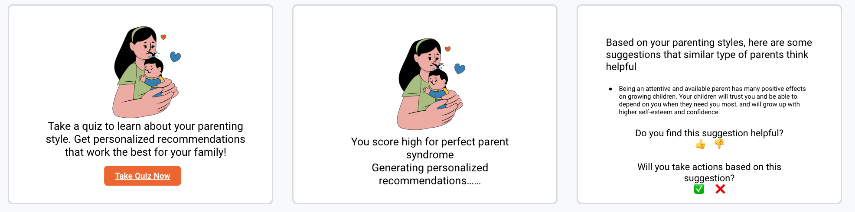

Experience Prototype 1
Step 1: take a survey (parenting style test)
Step 2: “generate” recommendations
Step 3: show recommendations
Melody
UX Researcher
5-year-old boy
We want to see if parents are open to suggestions and take actions based on their parenting style test results.

Slide 25
Solution 1 Results
We confirmed that parents are open to personalized suggestions and willing to take action. A “Quiz” is a good first step for self-awareness and opens parents’ minds about the different ways to handle conflict.
Things that worked
The 10-min quiz is too long; the quiz wasn’t customizable for children’s age range or marital status, so some prompts were irrelevant.
Things that didn’t work
Parents feel that even if we customize quizzes, AI might be inadequate to offer deep, relatable parenting advice; they prefer to build long-term consulting relationships with humans because they can understand the family better.
Surprises
Learnings
Parents are interested to know the consequences of actions they take to help them decide how to change their parenting style.
Being able to relate to emotions and interpersonal relationships is necessary to offer helpful parenting advice.

Slide 26
Solution 1 Results
Assumption validated
We confirmed that parents are open to personalized suggestions and willing to take action. A “Quiz” is a good first step for self-awareness and opens parents’ minds about the different ways to handle conflict.
Things that worked
The 10-min quiz is too long; the quiz wasn’t customizable for children’s age range or marital status, so some prompts were irrelevant.
Things that didn’t work
Parents feel that even if we customize quizzes, AI might be inadequate to offer deep, relatable parenting advice; they prefer to build long-term consulting relationships with humans because they can understand the family better.
Surprises
Learnings
Parents are interested to know the consequences of actions they take to help them decide how to change their parenting style.
Being able to relate to emotions and interpersonal relationships is necessary to offer helpful parenting advice.

Slide 27
Solution 2
A reward system for parents and children to encourage them to solve a problem together.

Slide 28
Solution 2
Assumption:
Parents and kids care enough about the rewards to participate.
Solution:
A reward system for parents and children when they solve a problem together.
Notes:
Assumptions: Parents and kids care enough about the rewards to participate.
Kids will be willing to cooperate with their parents and participate in a gamified way of resolving conflict.
Parents and kids care about rewards or positive feedback when they solve a problem (Users care about / have anticipation for receiving rewards and leveling up. )*
Children in conflict become less aggressive and angry when playing games with parents

Slide 29
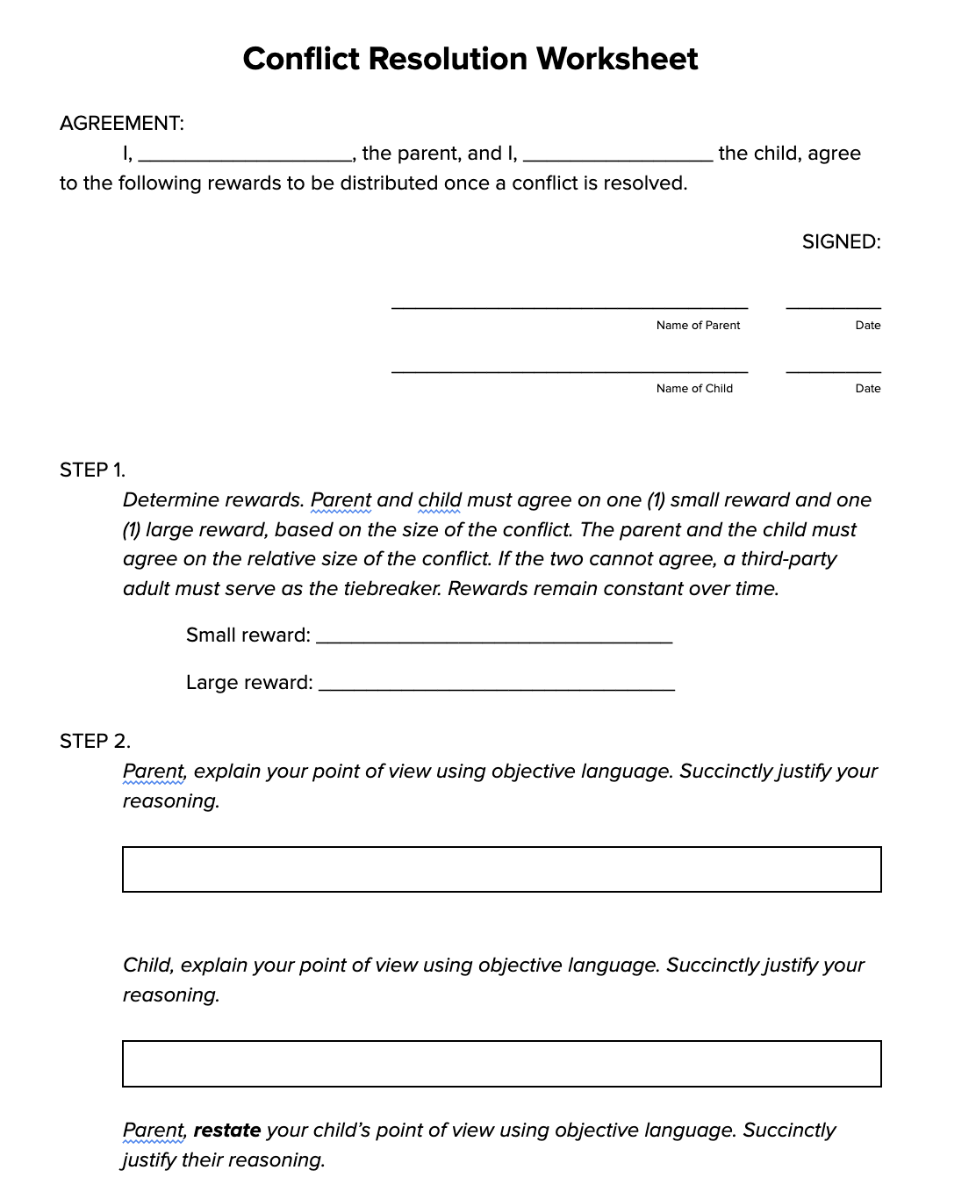
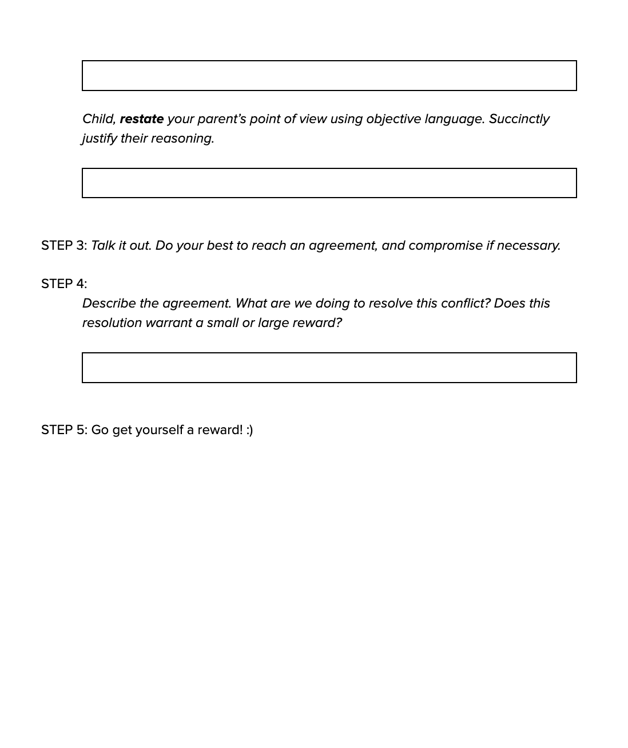

Experience Prototype 2
INTERVIEWEE
Dan
Lawyer, Stanford alum
10 y/o girl, 13 y/o boy
To test our assumption, we put together a worksheet for a parent and child to complete together that integrates our reward system. With Dan, we simulated a parent/child conflict and went through the worksheet together.

Slide 30
Solution 2 Results
Restating what the other person said in an objective manner
Reward to motivate the child
Things that worked
Child should be rewarded not for resolving the conflict, but for following through on the agreement.
Point system is out because children struggle with delayed gratification.
Things that didn’t work
Parents do not need a reward. The conflict being resolved is its own reward to the parent.
Third graders and older would be willing to sit down and use the worksheet, which requires maturity.
Surprises
Parents want a centralized place to memorialize resolved conflicts and remember agreements.
Rewards should change to keep kid motivated.
Learnings

Slide 31
Solution 2 Results
Assumption
partially validated
Restating what the other person said in an objective manner
Reward to motivate the child
Things that worked
Child should be rewarded not for resolving the conflict, but for following through on the agreement.
Point system is out because children struggle with delayed gratification
Things that didn’t work
Parents do not need a reward. The conflict being resolved is its own reward to the parent.
Third graders and older would be willing to sit down and use the worksheet, which requires maturity.
Surprises
Parents want a centralized place to memorialize resolved conflicts and remember agreements.
Rewards should change to keep kid motivated.
Learnings

Slide 32
Solution 3
Daily affirmations and empowering quotes.

Slide 33
Solution 3
Assumption:
Parents are willing to receive, read, and internalize the affirmations/quotes.
Solution:
Daily affirmations and empowering quotes.
Notes:
Assumptions: Parents are willing to receive, read, and internalize the affirmations.
Parents are willing to receive, read and appreciate the affirmations, taking them into account during the day when they interact with their children. (Affirmations and daily reminders are well written and parents are willing to read those)*
Parents want to have their notifications turned on
Daily reminders make parents feel like they are doing the right thing

Slide 34
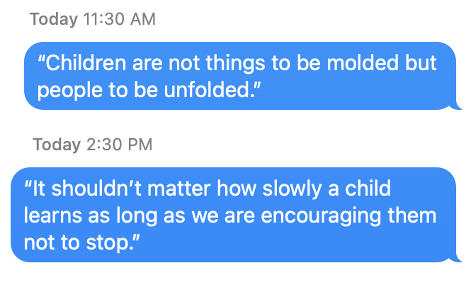
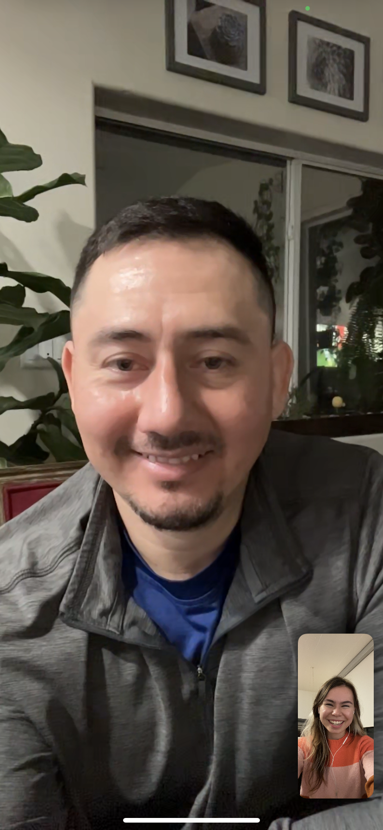
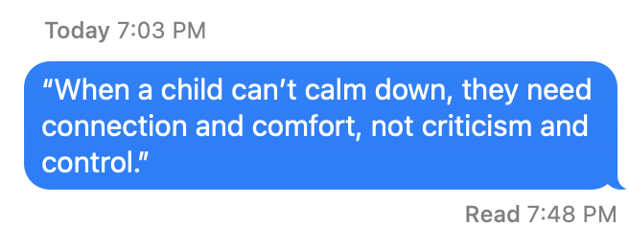
Experience Prototype 3
We texted 3 affirmations to a parent throughout one day, simulating
an app notification.
At the end of the day, we interviewed the parent about their experience and engagement.
Alvaro
Costco Employee
4-month old girl.

Slide 35
Solution 3 Results
When parents read parenting quotes/affirmations, they immediately apply them to their own life and how they interact with their child.
Parents enjoy affirmations because it sets a positive tone for the day.
Things that worked
Because the experience prototype was delivered over iMessage,
some of the quotes went unnoticed.
Things that didn’t work
Some parents are very willing to reflect upon and talk about their routines with their child without even being prompted.
Surprises
Parents prefer to receive notifications early in the morning (before work)
or later in the evening (after work).
When parents make the conscious decision to download the app, they will pay more attention to its notifications.
Learnings

Slide 36
Solution 3 Results
Assumption validated
When parents read parenting quotes/affirmations, they immediately apply them to their own life and how they interact with their child.
Parents enjoy affirmations because it sets a positive tone for the day.
Things that worked
Because the experience prototype was delivered over iMessage,
some of the quotes went unnoticed.
Things that didn’t work
Some parents are very willing to reflect upon and talk about their routines with their child without even being prompted.
Surprises
Parents prefer to receive notifications early in the morning (before work)
or later in the evening (after work).
When parents make the conscious decision to download the app, they will pay more attention to its notifications.
Learnings

Slide 37
Solution Overview
Guided exercises and personalized advice to promote
healthy communication and conflict resolution.
What
Conflict resolution is a major pain point for most parents. Parents feel more comfortable and at ease when receiving advice tailored to themselves. Guided exercises allow parents and children to validate each other’s feelings and view conflict objectively.
Why
Parents who prefer receiving advice by discussing live with human beings, rather than digital solutions or automated systems.
Who it leaves behind

Slide 38
Additional
Needfinding
Summary

Slide 39
Summary
Quiz
Personal Touch
Parents love to learn by answering questions.
Parents like to hear advice from people who understand them well.
Reward
Conflict
Children need rewarding more than parents.
Parents prefer guided conflict resolution to validate feelings.
Exercises
Affirmations
Parents learn healthy communication with practice.
Parents enjoy receiving and internalizing positive affirmations.
Conduct market research
Define the task and task flows
Brainstorm possible features
Next…

Slide 40
Additional
Needfinding
Q&A

Slide 41
Additional
Needfinding
Appendix

Slide 42
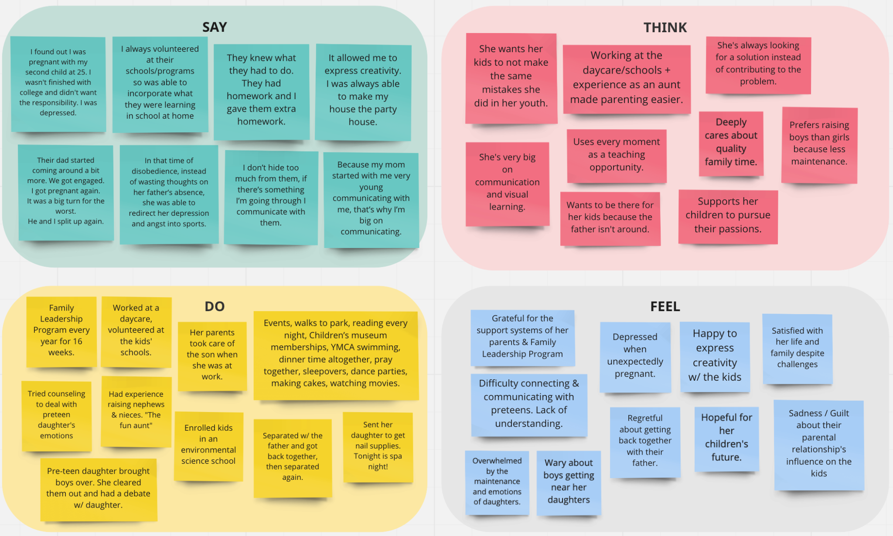
Empathy map for Tina

Slide 43
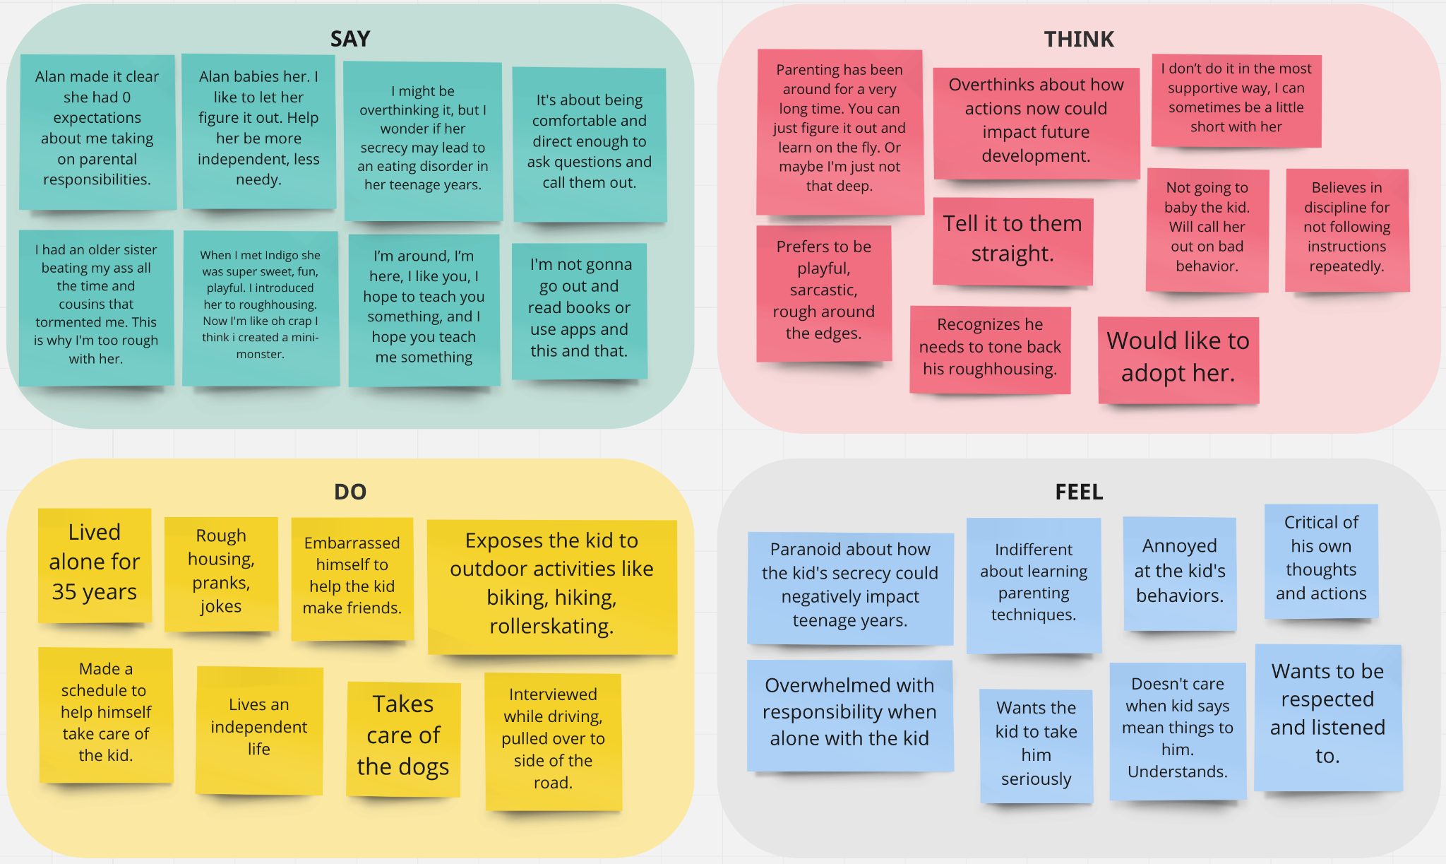
Empathy map for Felipe

